Slide 1
The Economic Downturn's Impact on the Financial Security of Older Adults
AIRS CONFERENCE
May 2010
Presented by:
Ramsey Alwin, Director of NCOA’s Economic Security Initiative, NCOA
Velma Smith, Sr. Executive Director of NY/VT/OH, PathStone Corp.

Slide 2
Overview
Provide demographic profile of economically disadvantaged older adults
Introduce a new national initiative using a person-centered approach to alleviate economic insecurity
Explore PathStone’s approaches to implementing a holistic approach

Slide 3
Profile: Economically Disadvantaged
What: Identified economically disadvantaged older adults measured by % of federal poverty level (FPL) and risk factors for economic insecurity
How: Using 2008 American Community Survey (ACS) and the 2008 Current Population Survey (CPS) Annual Social and Economic Supplement (ASEC) data for profile and secondary sources for risk factors
Why: To target services appropriately to those older adults most at risk for economic insecurity
Source:

Slide 4
Trends and Research Findings
31% of adults 65+ struggled to get by on income below 200% FPL
Women fared worse than men with, 38% economically disadvantaged compared to 23% of men.
White women comprised 50% of those below poverty; and
50% of Black women had income at or below 200% of FPL.
Communities of Color were disproportionally represented.
If net worth were figured into poverty estimates, the racial/ethnic gap in poverty would widen.

Slide 5
Employment
In 1990, only 42% of men and 28% of women ages 62-64 were in the labor force; by 2008 the rates had risen to 52% of men and 41% of women.
Due to the recession, 44% of workers age 50+ have delayed retirement.
The unemployment rate for age 55+ is at an all-time high (7%) with it taking on average 7 months to secure employment.
Inequities in employment trends persist:
In 2008, 56% of Blacks age 55-64 were in the labor force compared to 66% of Whites of the same age; and
Among age 55+, Hispanics had the highest unemployment rates (12.6%) during the peak in July 2009.

Slide 6
Savings and Debt
Due to the market’s decline, the Dow lost more than 50% of its value, and the value of equity assets in workplace retirement funds fell by $4 trillion.
96% of Americans age 65-69 with income below the poverty threshold possess retirement savings of less than $10,000.
According to a study released in late 2009, low- and middle-income consumers age 65+ carried $10,235 in average credit card debt in 2008.

Slide 7
Medical Costs
Between 1999 and 2008, premiums increased 119%, exceeding 34% growth in wages and 29% rise in inflation.
In 2006, almost 50% of older adults in the lowest third of the income distribution devoted one-fifth of their annual income to medical costs, including premiums, deductibles and other services not covered by Medicare.
Uninsured adults age 55-64 made up 9% of those without insurance in 2008.

Slide 8
Housing
Housing costs in excess of 30% of one’s income can jeopardize economic security. In 2008, this was the case for:
30% of homeowners 65+;
54% of renters 65+; and
41% of households 65+ in the Northeast.
During the recession, declines in home value ranged depending on region with highest declines in CA and AZ
Highest metro area: Los Angeles (-31%)
In 2008, individuals 50+ represented 28% of all foreclosures and delinquencies.

Slide 9
Thresholds by Race/Ethnicity, Gender & Age 65+

Slide 10
Age Matters: Income Under 200% of the Federal Poverty Threshold by Age, Race/Ethnicity & Gender, US, 2008
65+ | 40 | 968 | 522 | 6,824 | 431 | 29 | 301 | 143 | 210 | 3,108
75+ | 16 | 485 | 246 | 4,246 | 183 | 14 | 107 | 71 | 93 | 1,686
 |  |  |  |  |  |  |  | (numbers in thousands)

Slide 11
Geography Matters: States & Cities with the highest number of older adults living below 200% FPL
Note: 9 of the top 20 states are in the South.
Highlighted cities are economic security service center sites.

Slide 12
Summary: Risk Indicators and Profiles
Those living most at risk for economic insecurity by all measures include:
Individuals 75+
Communities of Color
White Women
Hispanic Women in the Northeast
Black Women in the South
American Indian & Native Alaskan Women 75+
Individuals Living Alone
Individuals with Housing Costs that Exceed 30% of Income

Slide 13
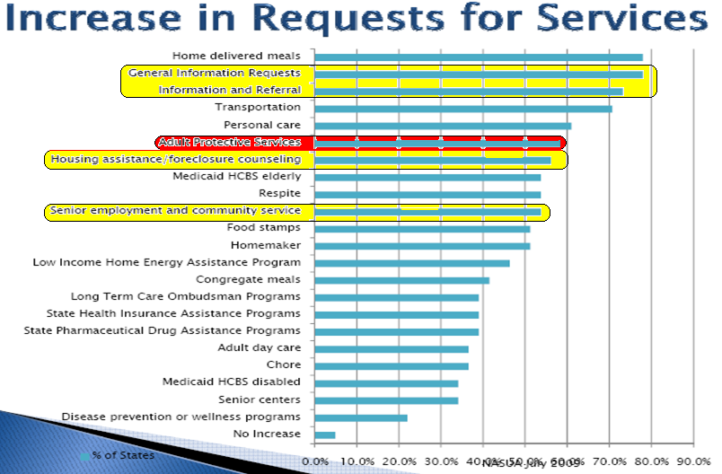
Survey: National Association of State Units on Aging July 2009
Nearly 80%
60%
Over 50%

Slide 14
Limitations to Current Assistance
Older adults with serious economic needs often cannot get a comprehensive review of their financial situation and gain an understanding of various public and private services that my help, including:
credit/debt counseling and consolidation,
foreclosure and bankruptcy assistance, and
timely and appropriate information regarding leverage home equity.
Services are generally not coordinated and often unresponsive to seniors.
Cold referrals with little or no follow-up.
Resources for “economic casework” are often inadequate or non-existent. If in place, focused on “moving out of poverty” as opposed to “toward economic security.”
Notes:
14

Slide 15
BETTER COORDINATION OF COMMUNITY SERVICES COULD HELP ADDRESS ECONOMIC SECURITY NEEDS OF OLDER ADULTS
Eligibility and enrollment assistance
Emergency assistance for housing/fuel/food
Jobs
Finances
Legal Services
Health
Housing
Public Benefits
Aging Network Services
Employment training
Skill assessments
Job placement
ECONOMIC CASEWORK & SERVICE COORDINATION
Credit counseling
Debt management
Daily Money Management
Financial literacy
Pre-lender HUD certified Reverse Mortgage counseling
Consumer protection/financial abuse
Guardianship
Representative Payee
Home and community-based services
Nutrition programs, transportation, etc.
Foreclosure counseling
Home repair
Housing options counseling
Renters assistance
Debt and lost pension services
Eviction prevention
End of life decisions
Assistance securing benefits
Health insurance counseling
Health promotion and disease prevention

Slide 16
Goals of the National Multi-Site Demonstration
Produce a “proof of concept,” that is, that holistic person-centered economic assistance services for older adults are found feasible and increase economic security;
Institute holistic person-centered economic services in eight to ten pilot communities with established plans for sustainability;
Serve 5,000 low-income seniors and help them to achieve greater economic security;
Engage national organizations and ensure that project learnings drive public policy recommendations and plans for program replication and scaling; and
Develop a shared increased understanding of:
the demand for economic assistance by seniors;
what it takes to develop, operate and finance various service models;
the needs not resolved through these services; and
baseline expectations regarding the investment and the return.

Slide 17
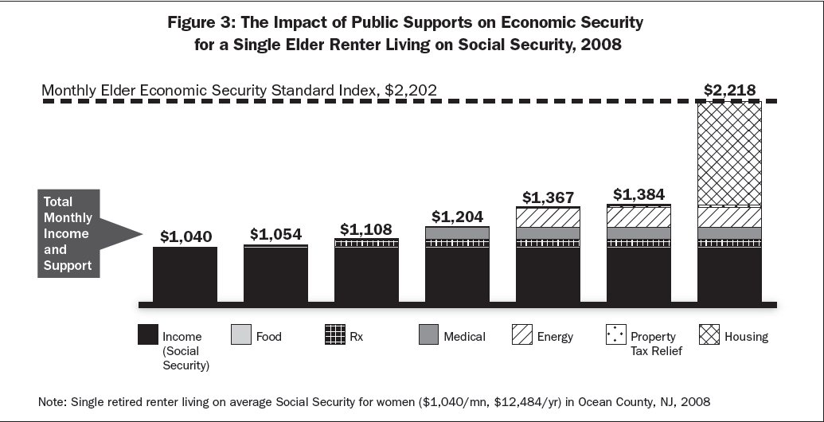
Closing the Gap
62% of economic security
47% of economic security
For more information, visit Wider Opportunities for Women – www.wowonline.org

Slide 18
Forging a Pathway to Economic Security
Since 2001, BenefitsCheckUp® has helped over 2.3 million people find over $7.3 billion worth of the annual benefits. The average person age 65 and older with an income of 125% of the federal poverty level (FPL) was eligible for and not receiving public benefits valued at $6,985 annually.
According to NCOA Reverse Mortgage Counseling research, the average low-income homeowner was found to be eligible for about $5,000 in public benefits and also qualified for a reverse mortgage that provided about $5,832 annually.
In 2007, almost 80% of older households owned a home and almost 65% had no mortgage. Although, about 13.2 million older adults are likely candidates for reverse mortgages, only 2% of older homeowners have drawn upon reverse mortgage services to date.
Health insurance counseling is another service that can save seniors money. In 2006 older consumers averaged out-of-pocket health care expenditures of $4,631. Older Americans spent 12.7% of their total expenditures on health, more than twice the proportion spent by all consumers (5.7%). Many consumers could save money by shopping more wisely for Medigap and Medicare Part D coverage.

Slide 19
NCOA’s National Economic Security Initiative
INPUTS
Financial support of $3 million over 3 years (Weinberg, Atlantic Phil, SCSEP, local cash match).
Current NCOA Benefits Outreach and Enrollment efforts, Policy & Advocacy Capacity, BenefitsCheckUp®, and Civic Engagement Models of Significant Service.
Corporate Sponsorship
Leverage: Networks of community partners and service organizations providing benefits assistance, job training and other direct assistance to low-income seniors.
ACTIVITIES
Multi-Community Initiative
Collaboratively develop, implement, and evaluate 12 innovative community-based interventions to address the economic security needs of at least 5,000 older adults
National Strategy and Vision
Convene national aging organizations to support local demonstration projects and to make recommendations for policy changes that will more holistically meet the needs of seniors affected by the economic downturn
Explore short-term and long-term policy and funding initiatives
Inform national policymakers
Decision Support Services
Beta test an “EconomicCheckUp” technology to enable a
person-centered assessment

Slide 20
Economic Security Service Center: Pilot Communities
National Multi-community Demonstration - Supported by Weinberg
Baltimore – Creating Assets, Savings, and Hope (CASH) Campaign
Chicago – AgeOptions
Cleveland – Department on Aging
Detroit – Area Agency on Aging
Los Angeles – Insight Center for Community Economic Development
(in partnership with the AAAs in the City & the County)
Milwaukee – Aurora Family Services with the Department on Aging
New York City – Lenox Hill Neighborhood House
Tucson – United Way of Tucson and Southern Arizona
SCSEP Resource Centers - Supported by DOL Stimulus
San Francisco, CA
Trenton, NJ
New York State – PathStone Corporation
Alexandria, VA

Slide 21

Help Create Economic Security—Share Ideas Online!
Share Your Big Ideas on The Exchange
(AgingExchange.org)
How can we make economic security
a goal of the Older Americans Act?
Post your ideas.
Read and vote on others’ ideas.
Trade Practical Tips on Crossroads
(NCOACrossroads.org)
Share lessons learned—and referrals to other
service providers.
Meet colleagues nationwide who you can call on for help.
Get their advice on your day-to-day challenges.

