Slide 1
Multidisciplinary Teams
Lessons from the Field
Presented by: Talitha Guinn, National Center on Elder Abuse Email: tguinn@gmail.com
LinkedIn: https://www.linkedin.com/pub/talitha-guinn/23/9b/3ba
Notes:
NOTE: Want a different image on this slide? Select the picture and delete it. Now click the Pictures icon in the placeholder to insert your own image.

Slide 2
Agenda
MDT models – Focus on SF Forensic Center
Case Studies
Challenges & Successes
Q&A
What’s in your dream team?
Small group action questions
Small group sharing

Slide 3
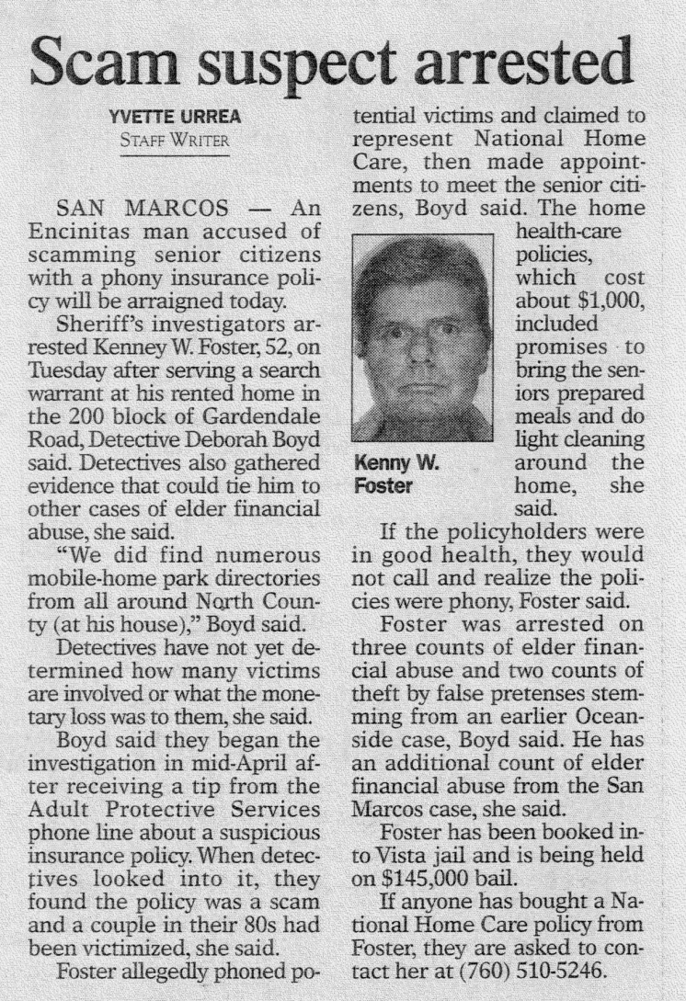
MDTs
Help those who help the vulnerable
Notes:
Jill

Slide 4
MDT Focus Areas
Case Review
Multidisciplinary teams/Interdisciplinary teams
Financial Specialist Teams (FASTs)
Centralizing Services
Elder Abuse Forensic Centers
Family Justice Centers
Improving Responses/Systems change
Coordinated Community Response
Elder Fatality Review Teams
Coalitions
NOTE: Many EA teams have more than 1 focus area
Notes:
If you would like to talk about types of elder abuse teams across the county, this slide can be used to provide a brief summary of the various types of teams. If you want to engage in a more detailed discussion of these categories of teams, the next 3 slides provide more information about these types of teams.

Slide 5
Ways to Collaborate
Informal
Formal
Structure and Membership
Leadership
Mission statement and bylaws
Rules or formalized procedures
MOUs
Notes:
There are many ways to collaborate. Efforts can be formal or informal or can move from one to the other. Examples of informal collaborations include two or more professionals from different disciplines agreeing to work together to develop a case plan, create a brochure, or train one another (cross training).
Formal teams typically have leaders, memoranda of understanding, standing members, and rules and procedures. Examples include community coordinating councils and task forces.
Neither structure is better than the other and both can be effective methods for accomplishing the agreed-upon work.

Slide 6
MDT Models from San Francisco
SF MDT
Community Service Providers, Names redacted, formed in 1981
Elder Death Reviews
Post adjudication, use names, open to community service providers, early 2000’s
Forensic Center
City Agencies, use names, formed in 2007

Slide 7
Forensic Center Models
Four Forensic Centers in California
San Francisco www.sfeafc.org
Orange County www.elderabuseforensiccenter.com
LA www.lacelderabuse.org
San Diego http://www.sandiego.gov/sandiegofamilyjusticecenter/services
Three similar models in US outside of CA
Texas www.uth.tmc.edu/schools/med/imed/divisions/geriatrics/team-institute.html
New York http://nyceac.com
Hawaii http://www.elderjusticehonolulu.com

Slide 8
SF Forensic Center Model
True public/private partnership
The Non-Profit Institute on Aging (IOA) & City and County of San Francisco
Partners are representatives from the following agencies:
DAAS
APS
Public Guardian (PG)
SFPD
District Attorney
City Attorney
Ombudsman
IOA – Coordinates FC
IOA contracts to provide
Geriatrician
Psychologist

Slide 9
SFEAFC - Mission
The San Francisco Elder Abuse Forensic Center will prevent and combat the abuse, neglect and exploitation of elders and dependent adults in San Francisco. This will be accomplished with the following strategies:
Improve communication and coordination among the legal, medical, social services professionals who investigate and intervene in cases of elder and dependent adult abuse.
Increase access to potential remedies and justice for those who have been victimized.
Educate policy makers, professionals, caregivers, older adults and their families about preventing, reporting, and stopping elder and dependent adult abuse.

Slide 10
Services
Forensic Review meetings – Formal case consultation by our multi-disciplinary team of professionals
Coordinated Homevisits – Two or more participating FC team members go to the client’s home together i.e. Police and an APS social worker, Geriatrician and Geropsychologist
Medical evaluations – Geriatrician evaluates medical/mental status at the request of the team

Slide 11
Services Continued
Medical record review – Geriatrician reviews to determine medical status/standard of care inquiries
Psychological/Neuropsychological Assessments – Geropsychologist conducts per request of the team
SFPD – Office Hours at APS
Collaboration with community partners and city agencies on elder abuse public awareness campaigns, education to professionals, and protocol.

Slide 12
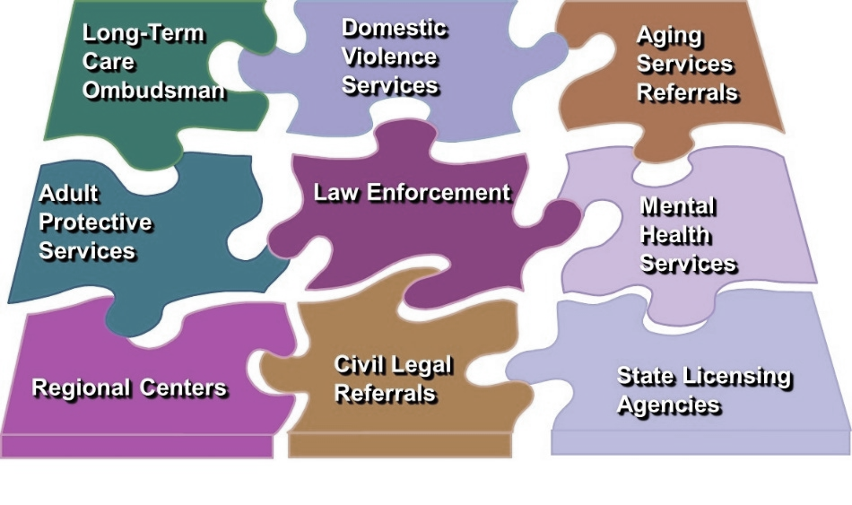
Forensic Review Meetings
Weekly 90 min. meetings at APS office 2-3 times a month
Discuss ~2 new cases and 3 follow up cases on average
Referrals of cases from any partner agency
Most initially from APS
Case Consultation
Examine case from a multidisciplinary perspective
Is this a crime? If so, what is needed for a successful prosecution?
What are our goals? Safety; Harm Reduction; Prosecution; Referral to other agencies
Discuss protocols, policy, and other “business”

Slide 13
Forensic Center Collaborative Interventions
Agencies & Clients
Criminal Remedies
Psych Services
Expert Recommendations
Civil (Conserve + Referral)
Expert Witness
Outreach & Education
Medical
Enhancing Safety
Notes:
Jill

Slide 14
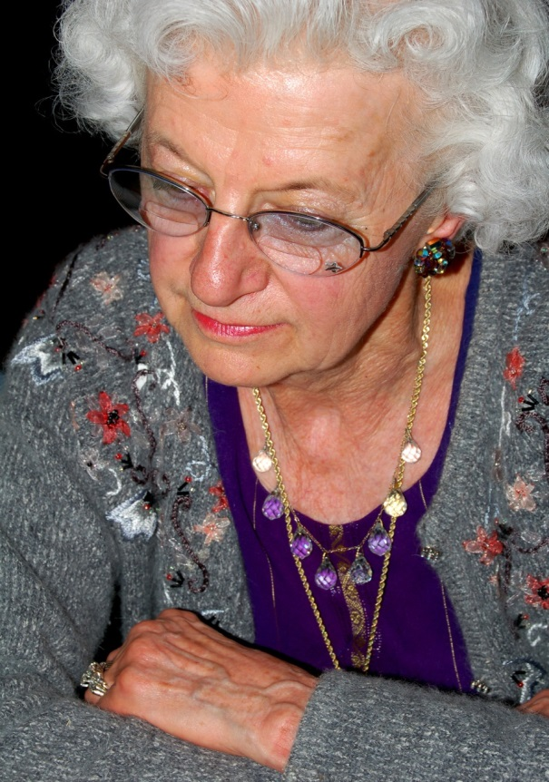
Case Study – Ms. A
Reported to APS by bank after a reverse mortgage paperwork submitted with a non-relative co-signer.
DPOA with client’s signature presented
APS worker sees client. Believes that she is demented and brings this case to the Forensic Center.

Slide 15
Case Study – Ms. A. FC Intervention
Psych eval requested.
Psychologist and APS visit home together AA says he is her boyfriend
Client says he is a nice boy and thinks that he is her son.
Her son has been deceased for 20 years
She is so demented that she cannot sign her name
Collateral interviews conclude that AA is daughter’s boyfriend
Daughter is a drug addict and has sold her mother’s car and many other possessions
PG files for conservatorship
Restraining order granted
Client placed in a safe facility. Assets protected and used for her care.

Slide 16
Benefits of Collaboration through the Forensic Center
Medical and Psych evals as a tool
Neutral communication forum
Efficient forum for case planning - meeting with multiple partners
Early interventions
More appropriate and robust referrals between agencies
Minimizing liability concerns by coming to consensus
Interdisciplinary Education
Enhanced understanding about the roles and challenges of each program/agency.
Medical, social work education for partners such as law enforcement and vise versa
Relationships are created and maintained
Common focus on helping vulnerable clients

Slide 17
Benefits of Collaboration through the Forensic Center
Specific to SF
Appropriate Conservatorship Referrals
Creative problem-solving happens during Forensic Center meetings.
Conservatorship seen by all as measure of last resort.
Geriatrician provides increased access to SF General Hospital to enhance safety
Use of 2900 to freeze assets during investigation
Contacting regulatory boards for follow up on abusers

Slide 18
Challenges
On-going Education Needed
- Rotation of Forensic Center partners
- Refreshers needed for APS/PG staff
Demonstrating the Efficiency Aspect of the Forensic Center to all partners
Building a Team
- Engaging assigned representatives vs. volunteer representatives
Agency Cultural Differences
Professional “Languages”

Slide 19
Challenges
Arriving at Consensus about Client Interventions
Lacking necessary Tools
Depending on “Watchful Waiting”
Challenging client portraits
Keeping key players engaged with the Forensic Center process.

Slide 20
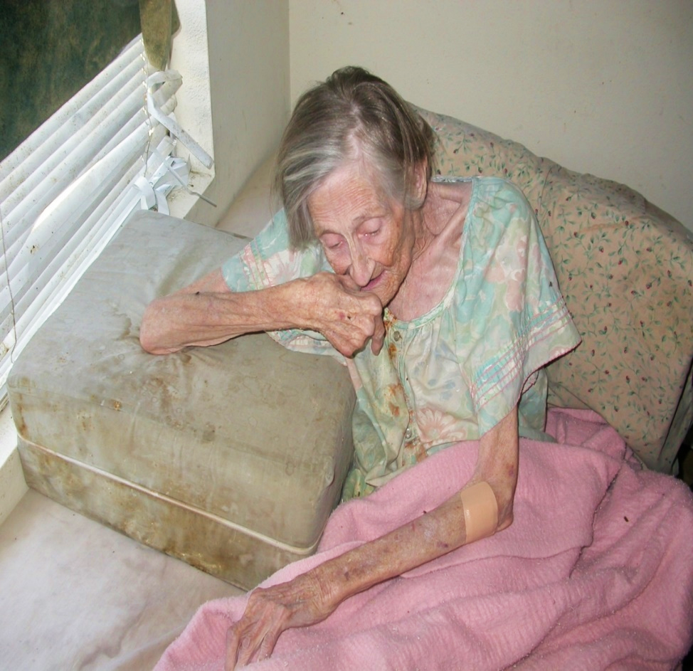
Case Study – Ms. Z.
Self Neglect
27 ROA to APS
Assistance rejected
Self-determination or right to folly
28th ROA from Hospital
Hoarding and Cluttering
Watchful waiting
Declining cognition
Five years of agency contact
Out-of-State family found and client relocated to safety

Slide 21
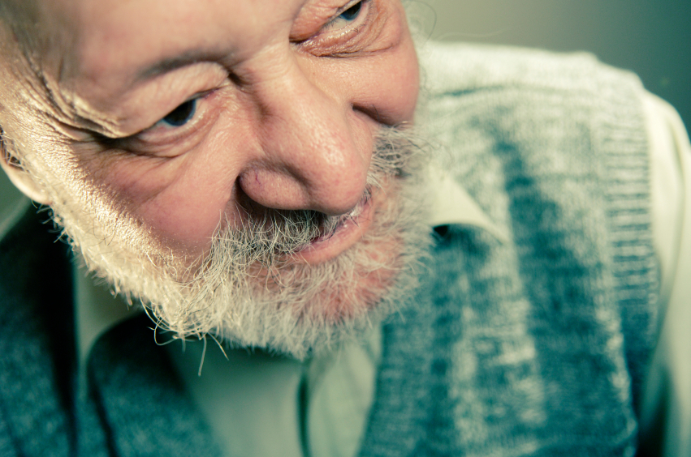
Case Study – Mr. W.
Setting the stage for success:
Mr. W. thought he won the lottery. All he had to do was send $40,000 overseas so that the taxes and handling fees would be covered. He mentioned this to the bank teller as he exited the bank with a money order in hand. The bank teller called APS. APS knew who to call at SFPD, the PG, and the DA’s office. That same day, the police were able to intercept the payment at FedEx before it went out, and saved Mr. W’s life savings. The PG prepared and served a “2900” on the bank to marshal his assets. The PG then petitioned for conservatorship after obtaining a psychological evaluation through the Forensic Center

Slide 22
Education and Outreach Example
Civil/Criminal Elder Financial Abuse Guide
Elder financial abuse can be both a civil wrong and a crime. Civil remedies primarily seek to help victims recover from the consequences of exploitation; criminal sanctions seek to punish and deter such wrongful conduct. both serve important public policy objectives and promote the legislature’s goal of reducing or eliminating elder financial abuse. While the same wrongful conduct can create both civil and criminal liability, the legal requirements and the practical considerations of each differ significantly. Generally, civil lawyers are unaware of the requirements for a successful criminal prosecution; similarly, prosecutors are often unaware of the requirements for a successful civil action. both may be frustrated that the other lacks greater interest or insight. The purpose of this publication is to bridge this gap by providing an overview of the law, issues, and practical concerns of elder financial abuse from both a civil and criminal perspective. its goal is to promote understanding between prosecutors and victim’s lawyers with the expectation that this will lead to greater cooperation and thereby help reduce elder financial abuse
Download the PDF here: http://www.ioaging.org/File%20Library/Abuse/CivilCriminalResourceGuide_0512.pdf

Slide 23
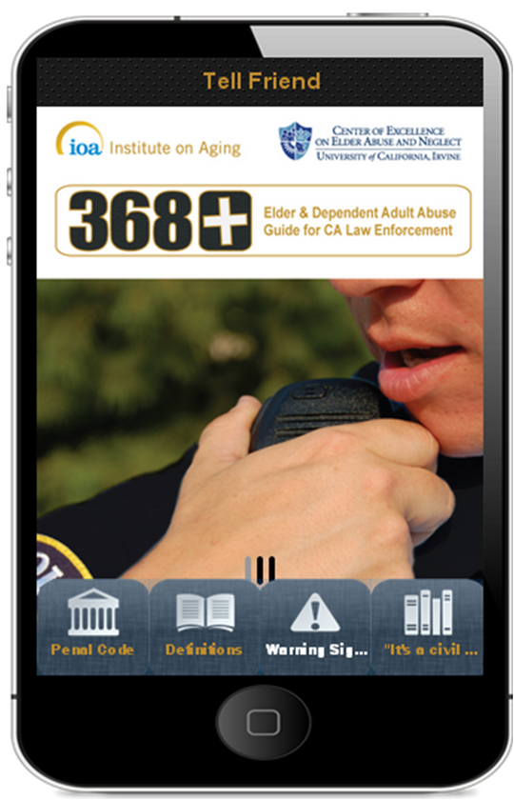
Education and Outreach Example
Elder Abuse Prevention - There’s an App for that!
Go to your app store and search ‘368’
Over 4000 downloads!
http://www.centeronelderabuse.org/368ElderAbuseCA.asp
Other Apps based on 368+
Boulder County Area Agency on Aging and
William Mitchell College of Law in Minnesota

Slide 24
Resources
Anetzberger, G.J. 2011. “The Evolution of a Multidisciplinary Response to Elder Abuse,” Marquette Elder’s Advisor, 13(1), available at scholarship.law.marquette.edu/cgi/viewcontent.cgi?article=1005&content=elders
Brandl, B., Dyer, C. B., Heisler, C. J., Otto, J. M., Stiegel, L. A., & Thomas, R. W. (Eds.). 2007. Elder abuse detection and intervention: A collabora­tive approach. New York, NY: Springer Publishing Co., LLC.
Twomey, M.S., Jackson, G., Li, H., Marino, T., Melchior, L.A., Randolph, J.F., Retselli-Deits, T., and Wysong, J. 2010. “The Successes and Challenges of Seven Multidisciplinary Teams, Journal of Elder Abuse and Neglect, 22(3/4): 291-305.

Slide 25
Links to Resources on Collaboration
National Center on Elder Abuse: www.ncea.aoa.gov/Stop_Abuse/Teams
National Clearinghouse on Abuse in Later Life (NCALL): http://www.ncall.us/community/collaboration
National Committee for the Prevention of Elder Abuse: www.preventelderabuse.org/coalitions

Slide 26
For Additional Resources, Visit www.ncea.aoa.gov
This slide set was created for the National Clearinghouse on Abuse in Later Life for the National Center on Elder Abuse and is supported in part by a grant (No. 90AB0002/01) from the Administration on Aging, U.S. Department of Health and Human Services (DHHS). Grantees carrying out projects under government sponsorship are encouraged to express freely their findings and conclusions. Therefore, points of view or opinions do not necessarily represent official Administration on Aging or DHHS policy.”

Slide 27
Q & A

Slide 28
Your Journey
What does your dream team look like?
Where will you go?
Where do you begin?

Slide 29
Small Group Springboard Questions
What is your vision for a MDT/Forensic Center? Formal vs. Informal
Who else is on board?
Who needs to be brought to the table?
What can you contribute to development/sustainability? (i.e. in-kind donations of office space or equipment, time, admin support, etc.)
Is there an agency/organization that can serve as the team coordinator?
Think about work groups to assist with mission statements, MOU development, logistical planning, public announcements, etc. What workgroup could you participate in. (Share your talents and passions with the small group.)
Commit to doing one thing to furthering the cause, even if it is just making a connection.

Slide 30
Small Group report back

